Slide 1
dMOdels – graphical user interface (GUI)
Maurizio Battaglia & Thy Do

Slide 2
Overview
I. Environment set up
II. Available functions
III. I/O Files handling
IV. Further assistance

Slide 3

I) Environment set up
1) Java platform
Latest Java environment installed on the device. (Java 8)
Java and dMODELS are not supported on mobile device.
Details on how to download and install a Java platform compatible with your device system can be found via this link: https://www.java.com/en/download/help/index_installing.xml
2) MATLAB MCR
Latest MATLAB Runtime installed on the device. (MATLAB MCR R2017a)
Details on how to install and update can be found here: https://www.mathworks.com/products/compiler/mcr.html

Slide 4
II) functions
1) Utilities
2) Running the inversion
- Choose data
- Choose source
- Input parameters
- Edit data file

Slide 5
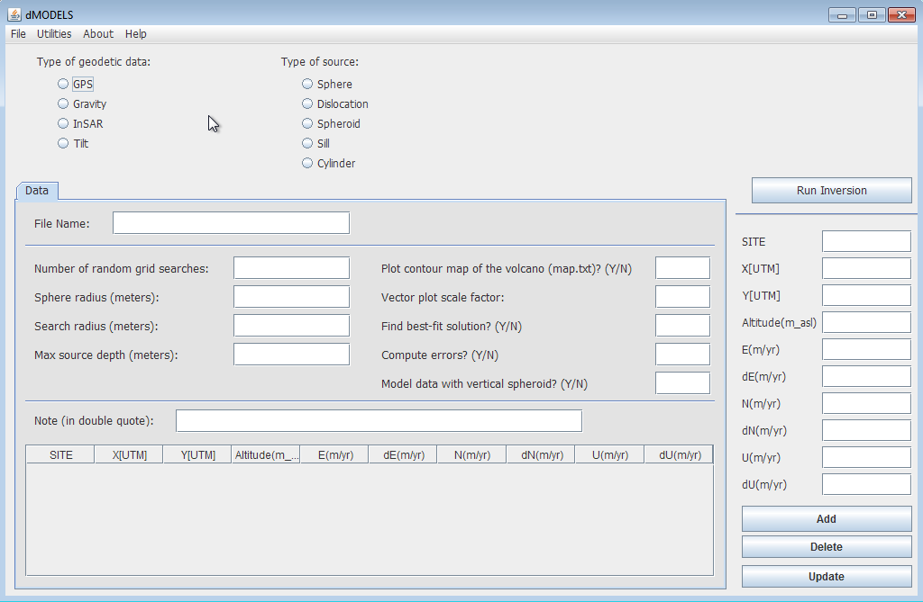

Slide 6
Utilities overview
LL-UTM Conversion
Create KML
Pre Processing

Slide 7
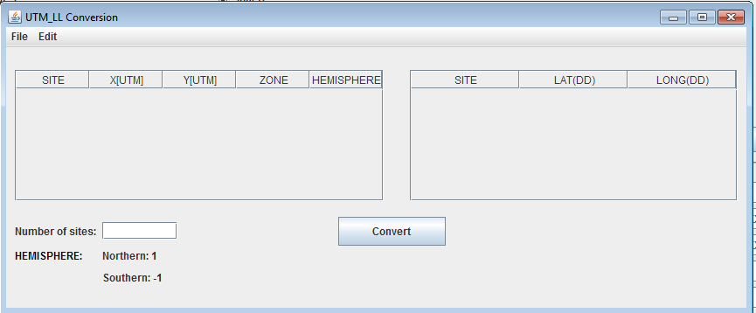
LL-UTM Conversion
Utilities -> UTM_LL Conversion
2 ways to input data:
File -> Open -> .txt file
File name should be strictly either
UTMfile.txt or LLfile.txt.
Manually input
-Enter number of sites.
-Fill in either one of the table with relevant data.
Click Convert to start the process.

Slide 8
LL-UTM Conversion
Save file:
Click File -> Save File: UTM file or LL file.
Reset table:
Click Edit -> Reset: clear all data available in both UTM and LL table.

Slide 9
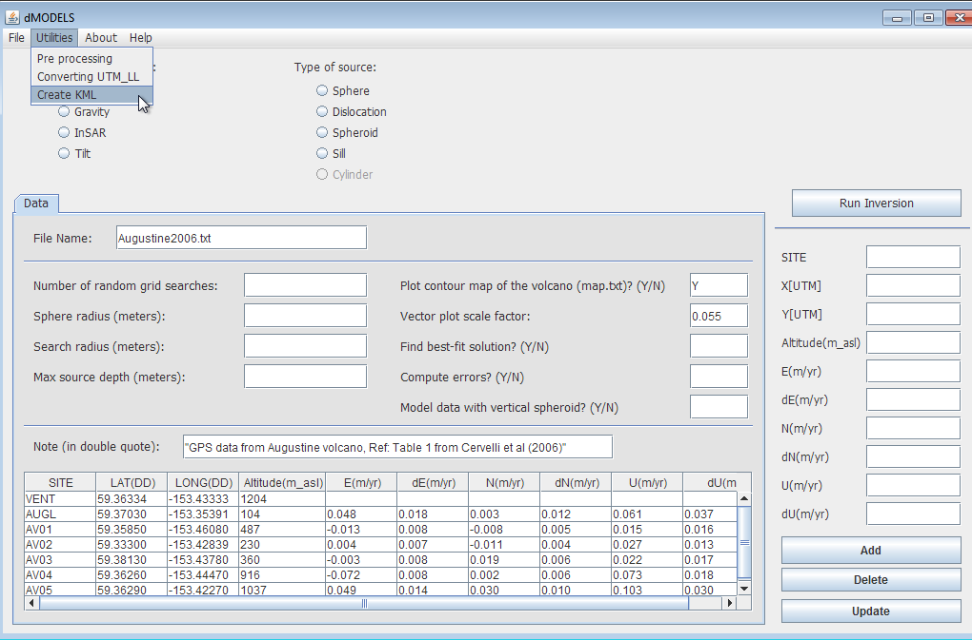
Create KML
Prerequisite:
Geodetic data file
Note coordinates in Lat, Long
- Only file name, whether you want to plot contour map and the vector plot scale factor are important.

Slide 10
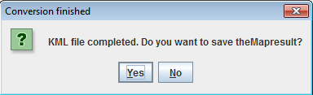
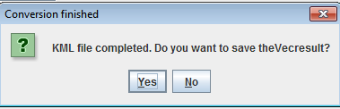
Create KML
Click Utilities -> Create KML. Wait for the application to process.
There are 2 types of output files. You will be prompted whether to save the result files. Click Yes to Save and No to proceed.
File name: [Volcano][Year].kml

Slide 11
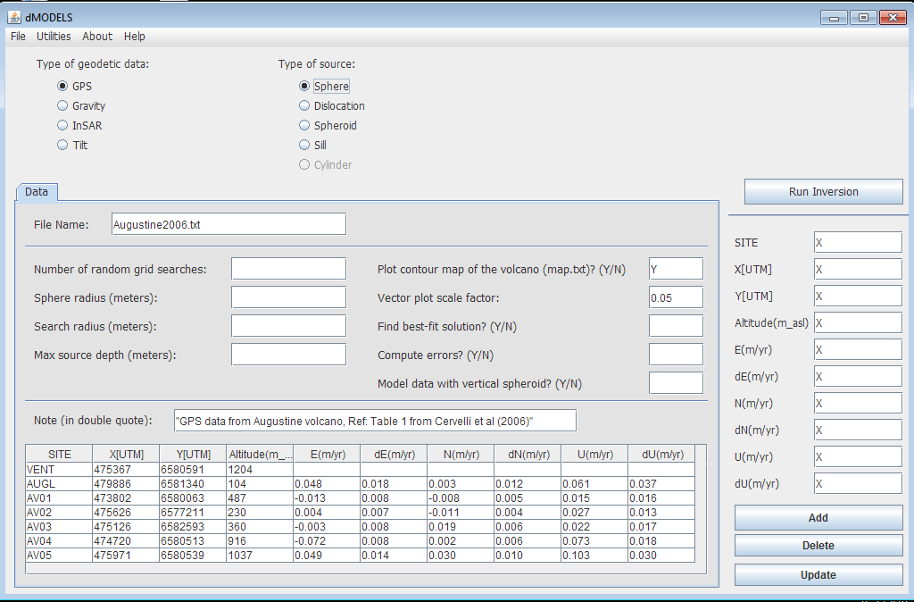
Pre-Processing
Prerequisite:
Geodetic data file
Note coordinates in X, Y
- Only file name, whether to plot contour map and scale factor are important
Click Utilities -> Pre Processing to run the application

Slide 12
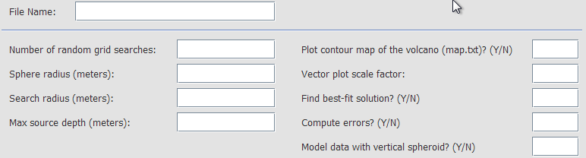
Running the inversion
Y/N choice:
-Plot contour map
-Best fit solution
-Error computation
-Model data with
vertical spheroid
(only spheroid source)

Slide 13
Running the inversion
In order to run the inversion code, you want to make sure these filled out:
Your geodetic data choice
Your source choice
Your Data tab with all parameters and data accordingly to your chosen source and geodetic data. (N/A for all blank space)
After all data and parameters filled in, click Run Inversion to proceed and receive the results

Slide 14
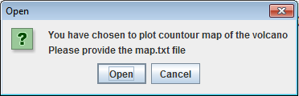
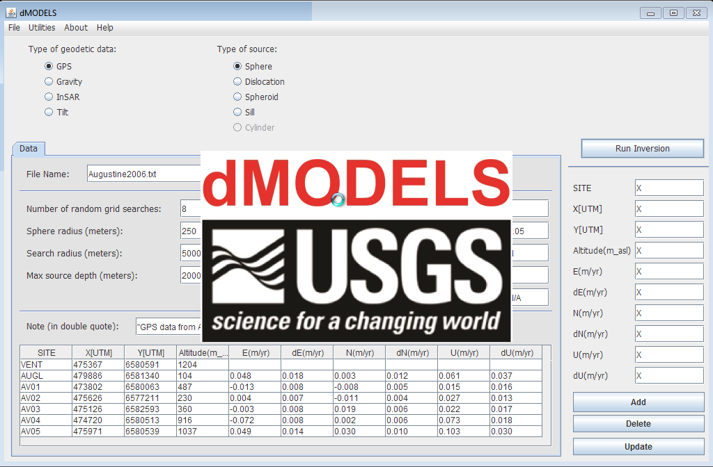
Running the inversion
If “Plot contour map” field is the map.txt file to proceed the inversion. indicated “Y”, you will need to import.
A logo will pop up indicating that the application is running, you should wait for a moment for the results to be displayed.

Slide 15
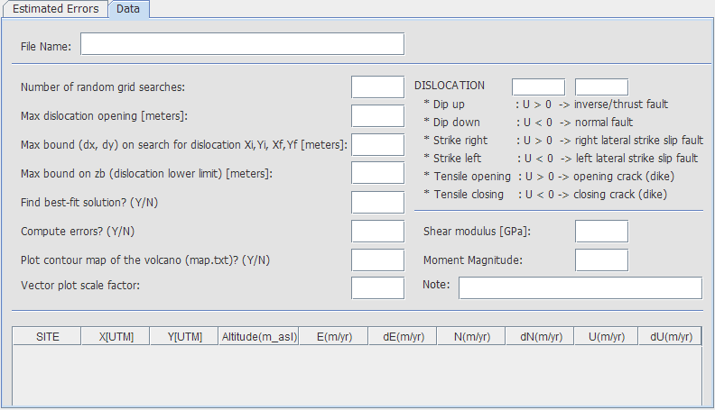
III) I/O files handling
How to input parameters?
There are 2 ways to input your parameters.
1) Import file (.txt):
* a parameter file that is strictly named “InputDataFile”.
*File -> Open -> Folder of file -> InputDataFile.txt
2) Manually import
*Make sure to put N/A to all the fields that are not applicable to your chosen type of geodetic data and source.

Slide 16
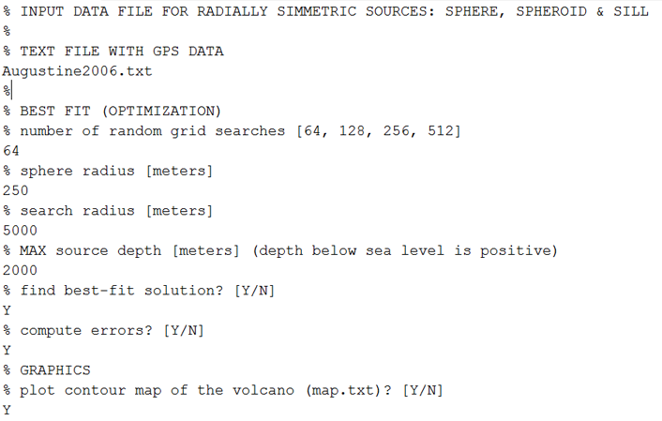
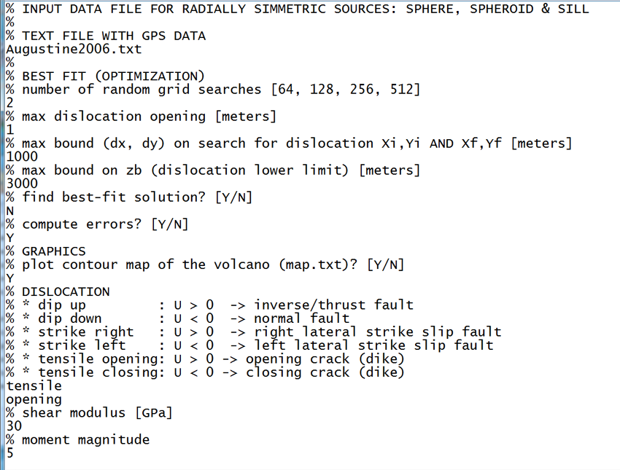
Inputdatafile.txt
Sphere and Sill
Dislocation

Slide 17
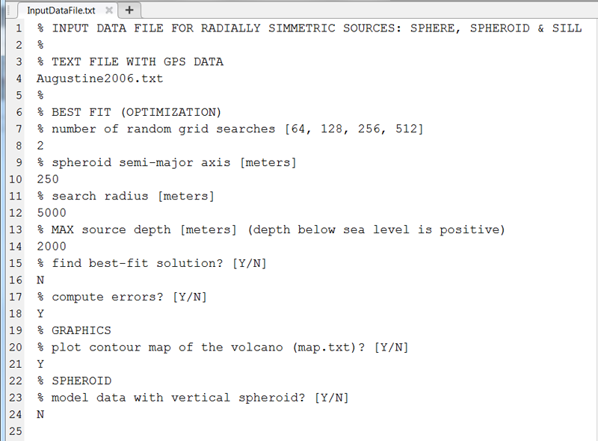
Inputdatafile.txt
Spheroid

Slide 18
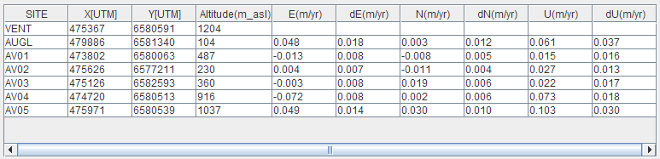
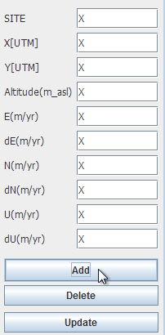
III) I/O files handling
B) How to input data?
There are 2 ways to import your data to the table.
1) Import the data file (.txt): a data file that is named with your project (ex: Augustine2006)
File -> Open -> Folder of file -> ProjectName.txt
Suggested name: [Volcano][Year].txt
2) Manually import the data from each site through the column on the right and click Add.

Slide 19
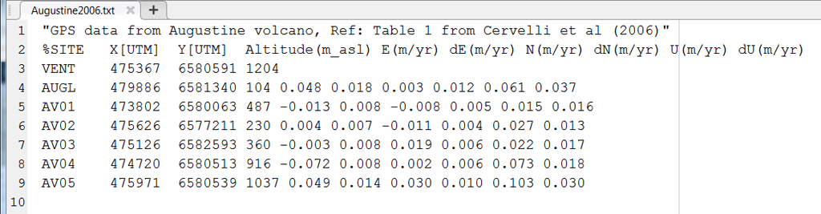
[Volcano][year].txt

Slide 20
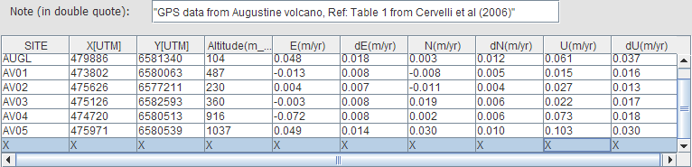
III) I/O files handling
C) How to modify the data in the table?
*Delete: Choose the row where you want to delete, click Delete.
This will remove the whole data of the chosen site.

Slide 21
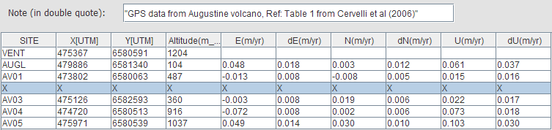
III) I/O files handling
*Update: Choose the row you want to update the data.
Fill in the new adjustment to the column on the right and click Update.
This will adjust your chosen row accordingly to the data filled in the column.

Slide 22
III) I/O files handling
D) How to save output files?
There are 2 types of output files:
1).jpeg (represented by separated windows)
To save the image file as .jpeg, click File -> Save in each image window.

Slide 23
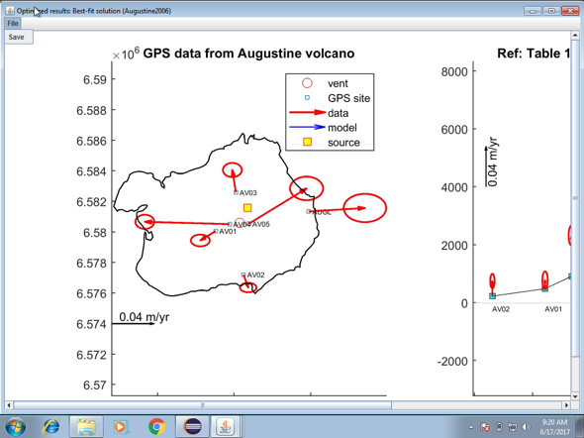
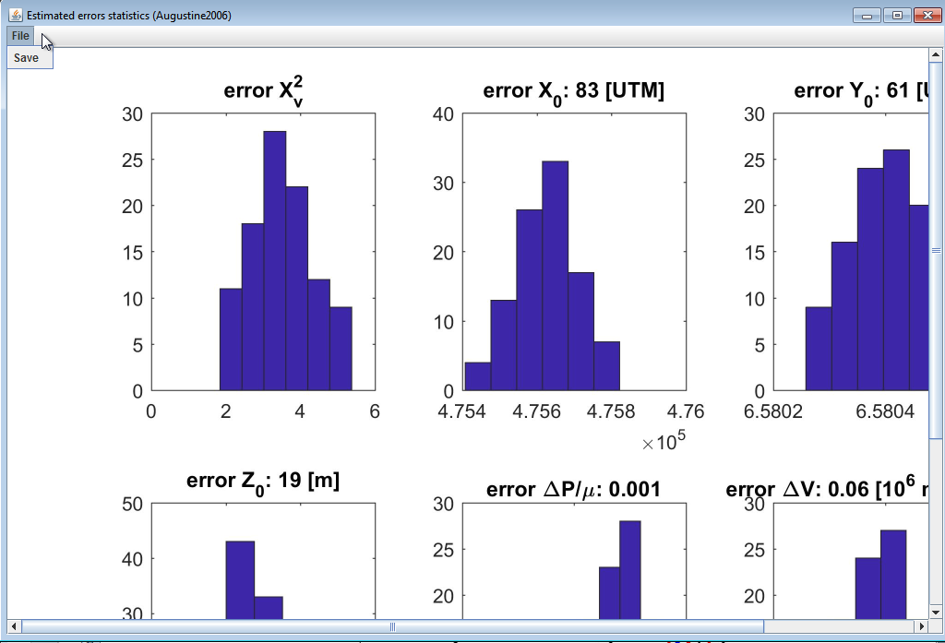
III) I/O files handling

Slide 24
III) I/O files handling
2).txt (represented by tabs)
To save file as .txt, click on the tab you want to save, click File -> Save Current Tab -> Yes

Slide 25
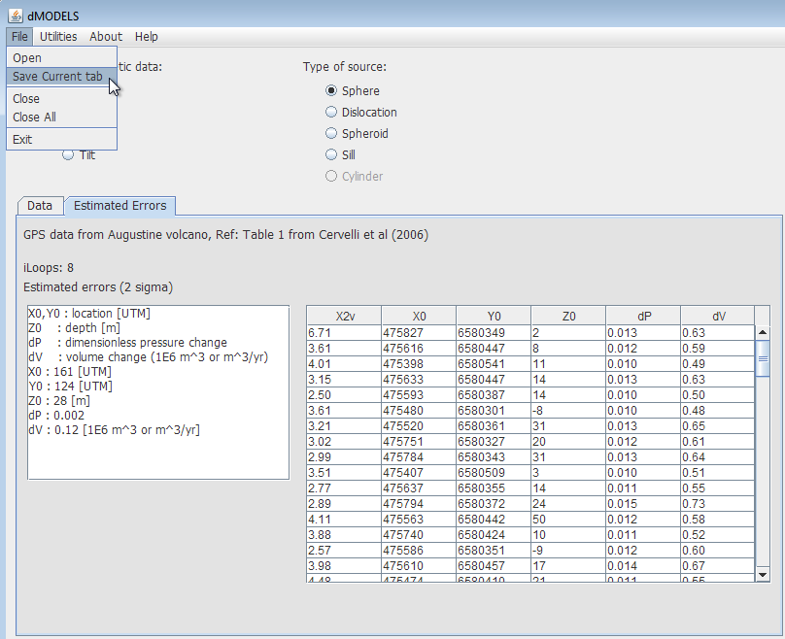
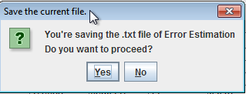
III) I/O files handling

Slide 26
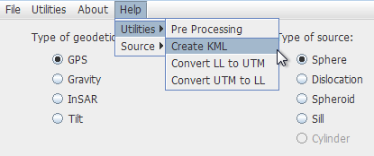
iV) Further assistance
*For further guidance on using the application, click Help.
*Should you encounter any problems or find any bugs, please contact doth01@gettysburg.edu

